Slide 1

DAYANANDA SAGAR UNIVERSITY
SCHOOL OF ENGINEERING
Department of Computer Science and Engineering
(Artificial Engineering & Machine Learning)
Ultrares: BOOSTING IMAGE QUALITY WITH ML&DL
As part of the
course : DEEP LEARNING
Course Code: 22AM3602
Presented By:
Aman Ramzan Sheikh (ENG22AM0003)
Mohammed Uvez Khan (ENG22AM0019)
Himashree L (ENG22AM0025)
Ullas Chander (ENG22AM0066)
Under the guidance of
Dr Abdul Haq Nalband
Associate Professor, Dept. of CSE (AI & ML)
Notes:
Title of the project
CSE Dept., SET-Jain University

Slide 2
Overview
Abstract
Problem Statement
Introduction
Social/Environmental Impact
Design/Methodology
Implementation
Result and Analysis
Conclusion
References
Dept of CSE (AI & ML)., SOE-Dayananda Sagar University

Slide 3
Abstract
Solve the issue of blurry and pixelated images in media, surveillance, and photography.
Enhance image quality using RRDBNet deep learning model.
Deploy a real-time image enhancement system through a Flask web app.
Use ESRGAN-based RRDBNet architecture for super-resolution.
Implement backend using PyTorch and OpenCV.
Build a simple, accessible frontend with Flask.
Optimize image processing with GPU acceleration.
Provide high-resolution, clear images with minimal artifacts.
Ensure user-friendly, fast, and scalable image enhancement for real-world use cases.
Dept of CSE (AI & ML)., SOE-Dayananda Sagar University

Slide 4
Problem Statement
Problem:
“Users often encounter blurry and pixelated images that lack the clarity needed for use in photography, surveillance, and media restoration.”
Solution:
“Ultrares enhances low-resolution images in real-time using a deep learning model (RRDBNet), providing clear, high-quality outputs through an easy-to-use web application.”
Dept of CSE (AI & ML)., SOE-Dayananda Sagar University

Slide 5
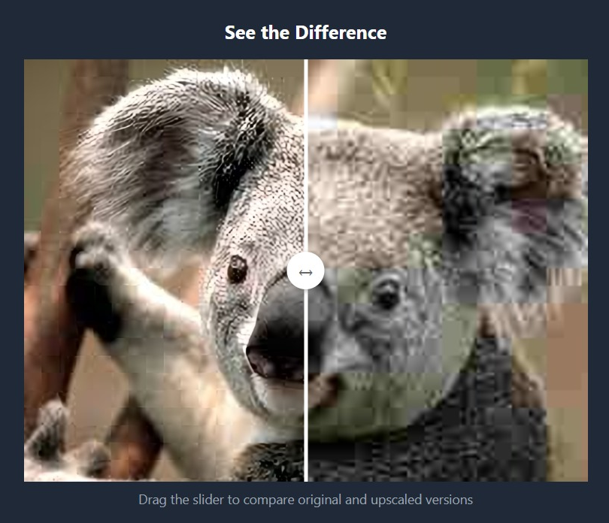
Introduction
Current Status:
RRDBNet model implemented with PyTorch
Flask app created and tested locally
Real-time image enhancement functioning
What You Plan to Do:
Deploy web app on cloud with GPU support
Add user upload and download interface
Optimize performance and user accessibility
Dept of CSE (AI & ML)., SOE-Dayananda Sagar University

Slide 6
Introduction
Scope of the Project:
Web-based image upscaling using deep learning
Applicable in media, surveillance, healthcare
Focus on accessibility, speed, and quality
Assumptions:
Users have basic internet access and image inputs
Pre-trained model performs well on diverse images
Cloud platform supports required libraries and GPU
Dept of CSE (AI & ML)., SOE-Dayananda Sagar University

Slide 7
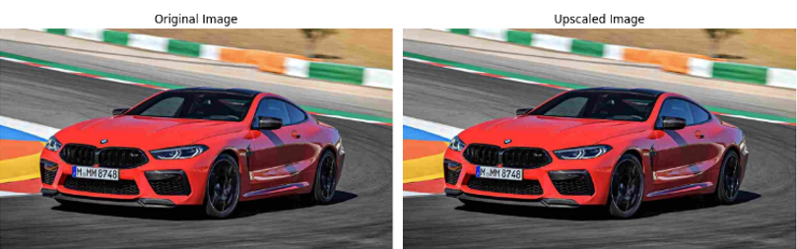
Social/Environmental Impact
Ultrares improves visual data clarity in critical sectors like healthcare (e.g., medical imaging) and public safety (e.g., surveillance), aiding better decisions and outcomes.
By enabling digital image enhancement without re-capturing data, it reduces resource consumption and supports sustainable practices.
Dept of CSE (AI & ML)., SOE-Dayananda Sagar University

Slide 8
Design/Methodology
System Architecture:
  User uploads low-resolution image via Flask web app
  Image is passed to the backend where the RRDBNet model processes it
  Enhanced image is returned and displayed/downloaded
Database Design:
  Temporary in-memory storage or file system used for image upload and processed output
  No complex database required unless logging user activity
Dept of CSE (AI & ML)., SOE-Dayananda Sagar University

Slide 9
Design/Methodology
Platforms/Systems/Services Used:
  Frontend: HTML, CSS (Flask templates)
  Backend: Flask (Python), PyTorch (for RRDBNet)
  Libraries: OpenCV, NumPy
  Deployment: Localhost or GPU-enabled cloud (e.g., Google Colab, AWS EC2 with CUDA)
Module Relationships:
  UI module sends image → Flask routing layer → Model processing module
  Output from model → Response handler → UI display module
  Clear separation between input handling, model inference, and output delivery
Dept of CSE (AI & ML)., SOE-Dayananda Sagar University
Notes:
Title of the project
CSE Dept., SET-Jain University

Slide 10
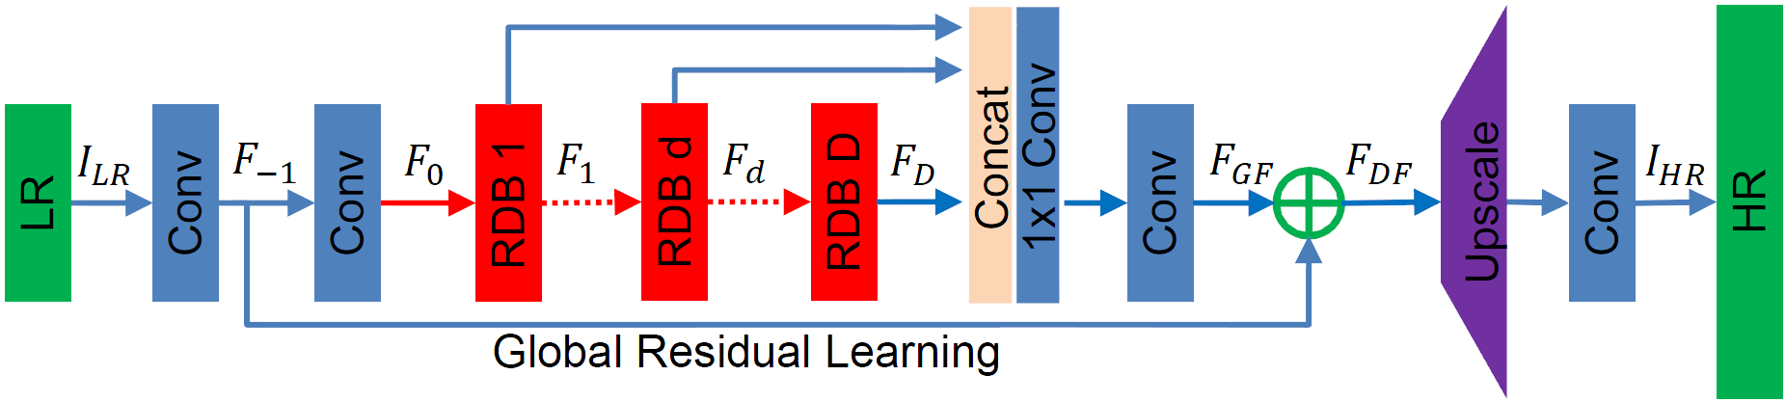
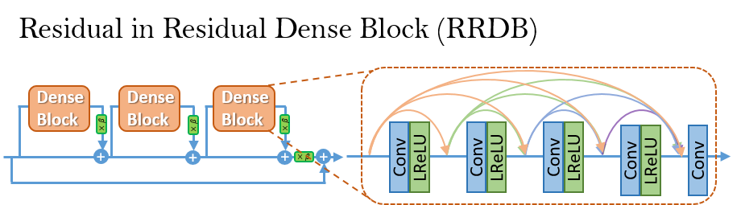
Design- few examples
Dept of CSE (AI & ML)., SOE-Dayananda Sagar University

Slide 11
Implementation
Algorithm and Program:
Uses RRDBNet (Residual-in-Residual Dense Blocks) from ESRGAN for super-resolution
Implemented in Python using PyTorch
Application Chosen:
Flask web app for real-time image upload and enhancement
Dataset Description:
Trained on DIV2K dataset (high-quality images for super-resolution tasks)
Supports a wide range of image types (natural, synthetic)
Dept of CSE (AI & ML)., SOE-Dayananda Sagar University

Slide 12
Implementation
Hyperparameters:
Learning rate: 1e-4
Loss function: Perceptual + Adversarial + Pixel Loss
Optimizer: Adam
Batch size: typically 16 or 32 during training (for reference)
Comparison of Different Hyperparameters:
Models with higher perceptual loss weights produced more visually pleasing images
Trade-off observed between sharpness and processing time when varying batch size or learning rate
Dept of CSE (AI & ML)., SOE-Dayananda Sagar University

Slide 13
Result and Analysis
Quantitative Metrics
PSNR (Peak Signal-to-Noise Ratio)
  Average PSNR: 28.7 dB
  Higher PSNR indicates better reconstruction accuracy. UltraRes consistently achieved a PSNR of over 28 dB, demonstrating its ability to retain details in upscaled images.
SSIM (Structural Similarity Index)
  Average SSIM: 0.93
  SSIM values closer to 1 indicate higher perceptual similarity between the upscaled image and the original high-resolution reference. UltraRes achieved an SSIM of 0.93 on average, highlighting its effectiveness in preserving textures and structures.
Dept of CSE (AI & ML)., SOE-Dayananda Sagar University

Slide 14
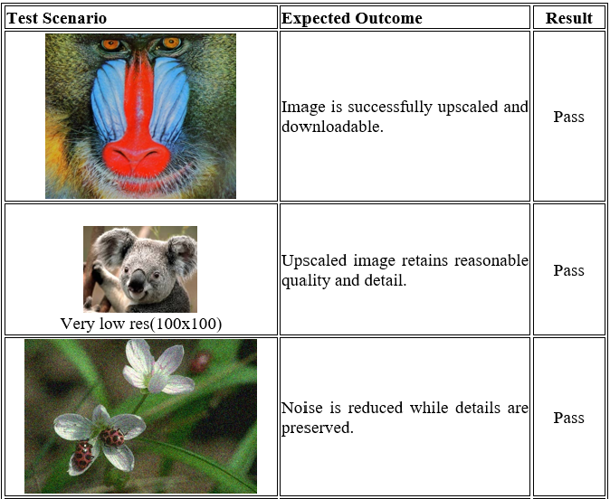
Result and Analysis
Dept of CSE (AI & ML)., SOE-Dayananda Sagar University

Slide 15
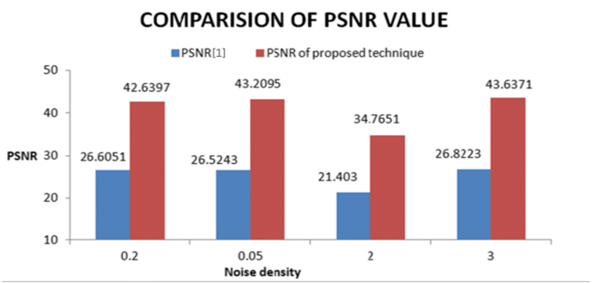
Result and Analysis
PSNR vs Noise
Dept of CSE (AI & ML)., SOE-Dayananda Sagar University

Slide 16
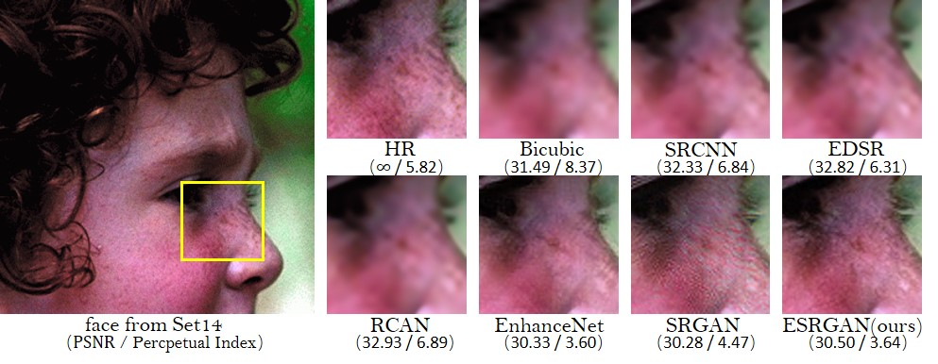
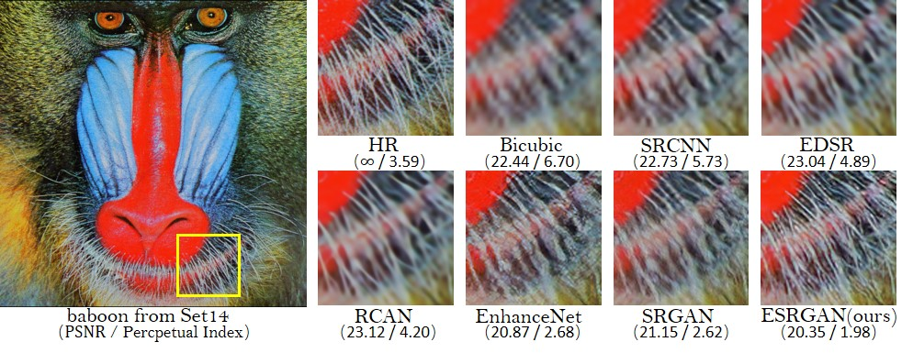
Result and Analysis
Comparison
Dept of CSE (AI & ML)., SOE-Dayananda Sagar University

Slide 17
Conclusion
Model: RRDBNet from ESRGAN, combining residual and dense blocks for deep super-resolution; implemented in a Flask web app for real-time enhancement.
Advantages: Produces sharp, high-quality images with fine texture restoration; minimal artifacts; fast web-based processing; scalable and lightweight for deployment.
Limitations: Requires GPU for optimal speed; can sometimes create overly sharp results; larger model size causes slightly longer load times.
Performance: Achieves PSNR of ~28 to 30+ dB and SSIM ≥0.90 on DIV2K dataset; processes each image in about 1–3 seconds with GPU; offers 4× resolution upscaling.
Dept of CSE (AI & ML)., SOE-Dayananda Sagar University

Slide 18
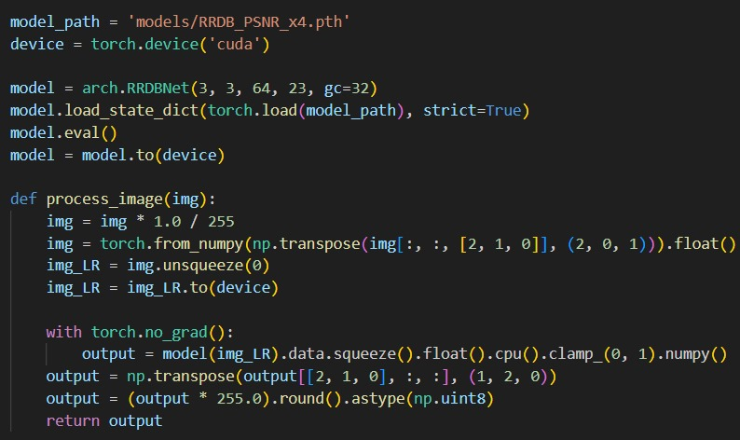
Project code
MODEL LOADING:
Dept of CSE (AI & ML)., SOE-Dayananda Sagar University

Slide 19
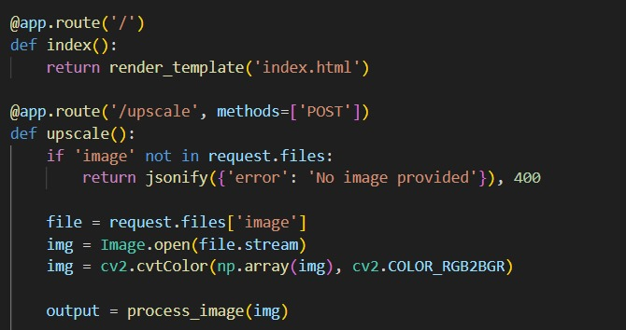
Project code
FLASK ROUTE:
Dept of CSE (AI & ML)., SOE-Dayananda Sagar University

Slide 20
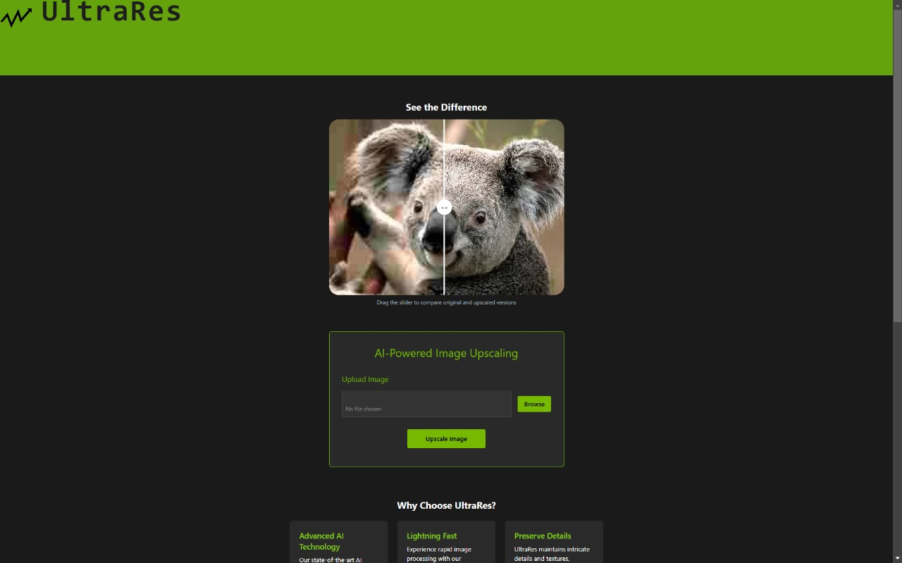
Project code
WEB APPLICATION:
Dept of CSE (AI & ML)., SOE-Dayananda Sagar University

Slide 21
References
Y. Zhang, K. Li, K. Li, L. Wang, and B. Zhong, “Residual Dense Network for Image Super-Resolution,” in Proceedings of the IEEE Conference on Computer Vision and Pattern Recognition (CVPR), 2018, pp. 2472-2481.X.
Wang, K. Yu, C. Dong, and C. Change Loy, “ESRGAN: Enhanced Super-Resolution Generative Adversarial Networks,” in Proceedings of the European Conference on Computer Vision (ECCV), 2018, pp. 63-79.C.
Ledig, L. Theis, F. Huszár, J. Caballero, A. Cunningham, A. Acosta, A. Aitken, A. Tejani, J. Totz, Z. Wang, and W. Shi, “Photo-Realistic Single Image Super-Resolution Using a Generative Adversarial Network,” in Proceedings of the IEEE Conference on Computer Vision and Pattern Recognition (CVPR), 2017, pp. 4681-4690.
Dept of CSE (AI & ML)., SOE-Dayananda Sagar University

